Slide 1
Ratio Analysis and Equity Valuation
Doron Nissim
Stephen H. Penman

Slide 2
1
Abstract & Objective
CONTENTS
2
Value Model-Identify
3
Value Model-Document
4
Summary & Reflection

Slide 3
Abstract and Research Objective
PART 1

Slide 4
Abstract and Research Objective
Abstract
This paper outlines a financial statement analysis for use in equity valuation. Standard profitability analysis is incorporated, and extended, and is complemented with an analysis of growth. The perspective is one of forecasting payoffs to equities.
General Value Analysis and Forecast: Financial statement analysis → pro forma analysis of the future (forecasted ratios viewed as building blocks of forecasts of payoffs).
Detailed Components Analysis Focused on Equity: Current financial statements → current ratios → future ratios driving equity payoffs. (financial statement analysis is hierarchical, with ratios lower in the ordering contain finer information).
To provide historical benchmarks for forecasting, typical values for ratios are documented for the period 1963-1996, along with their cross-sectional variation and correlation. And, again with a view to forecasting, the time series behavior of many of the ratios is also described and their typical “long-run, steady-state” levels are documented.
Notes:
The analysis become more narrowed down to components leading to change on the value of future equity. Then the authors pull out the time series data of financial statements and try to identify a ‘general” model and to test on the theories they have. The analysis is done from two perspectives: components interaction and historical testing.

Slide 5
Abstract and Research Objective - Identify
Model and Value Selection
Analysis Method
Application and Extension
Valuation Model and Financial Statement have same accrual-basis.
Comprehensive Income coincides with FASB
Operating and financing activities separation–M&M Proposition.
Asset value traits – fair value.
More hierarchical and fine, combine profitability with growth.
Value drivers are classified into “transitory” and “permanent”.

Slide 6
Abstract and Research Objective - Documentation
Resolve ratios that are defined differently from standard texts.
Find interaction between value drivers for forecasting and valuation.
Cross-sectional analysis
Time series analysis
Model requirement – Continuing Value requires ‘steady state’
Find general model – identify ‘transitory’ and ‘permanent’.

Slide 7
Residual Valuation Model - Identification
PART 2

Slide 8
Residual Income Valuation Model
Impractical for infinite-horizon forecasting, so model is modified with original part works for finite-horizon and Continuing Value is added at the forecast horizon T.
Model
Ratio
Drivers
RE & ROCE
Primary value drivers with detailed drivers
Notes:
Impractical for infinite-horizon forecasting, so model is modified with original part works for finite-horizon and Continuing Value is added at the forecast horizon T.
Incorporate g (growth) into the model for the first time.
Forecast RE and decide CV version.

Slide 9
The Drivers of ROCE - Decomposition
ROCE is a weighted average of the return on operating activities and the return on
financing activities. Income statement amounts are for the period and balance sheet amounts for the beginning of the period
Thus ROCE is driven by the return on operations with an additional return from the leverage of financial activities. This leverage effect is determined by the amount of leverage and the spread between the return on operations and net borrowing costs.
This decomposition of RNOA into PM and ATO follows the standard DuPont analysis.

Slide 10
The Drivers of ROCE - Decomposition
PM captures profitability of each dollar of sales, and it also captures items not recorded in sales, such as equity share of income in a subsidiary, dividends, and gains and losses on equity investments marked to market. So we decompose further,

Slide 11
The Drivers of ROCE - Decomposition
Put Minority Interest into consideration

Slide 12
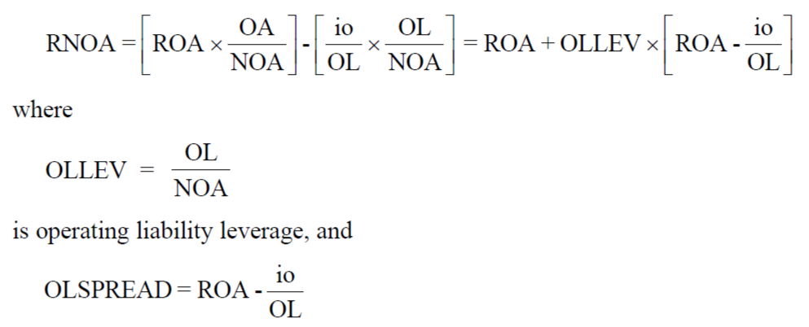
The Drivers of ROCE - Decomposition
Put Operating Liability into consideration
RNOA is levered up by operating liability leverage and the leverage effect is determined by the operating liability leverage and the spread between ROA and the implicit borrowing cost

Slide 13
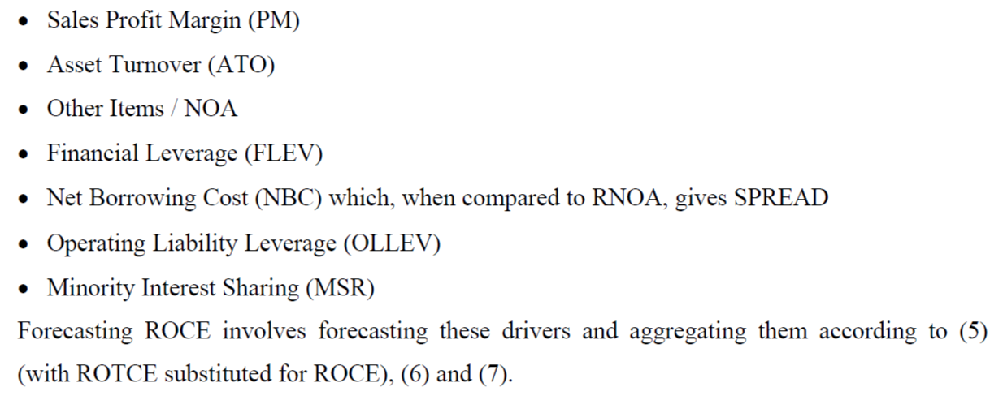
ROCE Value Drivers
Notes:
Correspondingly, these three equation put other items in operating income, minority interest, and operating liability and leverage on operating into consideration. Breaking them down and following the hierarchy, also only including ratios in the higher level of the structure, this paper found seven drivers of ROCE.

Slide 14
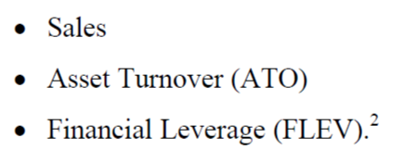
The Driver of CSE
When it comes to Book Value, the other part of valuation model, the breakdown shows that the Minority Interest is not within the equation. The last term of the equation captures the financial decision.
Now the value drivers identification is finished, the authors have identified totally 10 value drivers corresponding to ROCE and CSE. In order to make the analysis more consciously, the paper continues to reduce the analysis by splitting operating and financing.

Slide 15
Reduce the analysis
If financial obligation and assets are measured at market value, then the incremental part of NFO will be zer0, this reduces ReNFE to 0.
Now we convert RE into ReOI, and we do not need to find value drivers of ROCE and RE, instead we redirect the identification to RNOA and NOA.

Slide 16
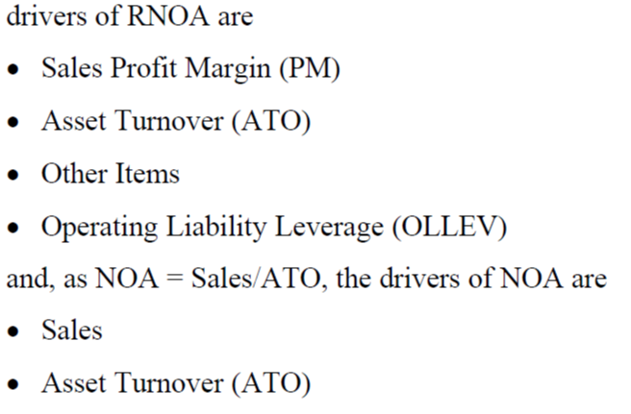
Reduce the analysis
Now there are only 6 value drivers, which corresponds to RNOA and NOA.
Up till now, the analysis is focused on finite part, then the authors focus on infinite part – CV and its growth rate.

Slide 17
The Drivers of CV and Growth
Constant RONA ------------ NOA
Constant RNOA, constant PM, constant ATO -------------- NOA (Sales)
Varying RNOA and constant NOA ---------------- RNOA

Slide 18
Financial Statement Analysis – Forecasting
The model is expected to give the right valuation and also the forecasting, so the authors classify “permanent” items as “Core Items” and these ratios/accounts will not decay.

Slide 19
Documentation
PART 3

Slide 20
Documentation – Cross Sectional
RNOA is higher at the mean and median than the traditional ROTA, so typically operating liability leverage is used favorably, contributing to the difference between RNOA and ROTA.
Verify the theory
Time series analysis
FLEV capture operations such as buying financial assets and operating liability. However, Debt/Equity does not reflect these two.
FLEV~SPREAD: Historical data shows that both spread and RNOA are negatively related to FLEV, contradicting to the predicted relationship.
OLLEV~OLSPREAD: positive relationship indicates that the OLSPREAD could lever RNOA up.
RNOA~Growth in NOA: One might expect firms that generate higher RNOA to grow their net operating assets. But growth in NOA reduces RNOA if the accounting is conservative. The value driver of RNOA is positively related with RNOA, but is slightly.
Interaction
Interaction
Notes:
Interaction: Explanation might be that the RNOA/SPREAD reflects business risk, and companies are more inclined to reduce financial risk accordingly.
RNOA and Growth in NOA combine to grow residual operating
income. One might expect firms that generate higher RNOA to grow their net operating assets

Slide 21
Documentation – Time Series
Construct 10 portfolios, restructure them every 5 years by average of median return. Companies below certain thresholds will be dropped out.
Corr – correlation of the new portfolios with the old ones; high Corr indicates that the ratios persist.
Var – qualify the speed of mean reversion, the higher the Var, the higher volatility of the drivers.
RE has momentum and converges, but gradually decays.
Forecasted RE , ReOI is positive, but the real value is positive, indicating that the assumed equity risk premium is too high, but uncertain about conservative accounting.

Slide 22
Summary and Reflection
PART 4

Slide 23
Summary and Reflection
Improvement
Uncertainty – assume business grows and continues smoothly, does count additional investment or unexpected expenses, reflected in discount rates.
Summary
Structure - hierarchical financial statement analysis that facilitates forecasting and valuation.
Extension - Expand analysis from profitability to growth.
Universality - Analysis structure works on Residual Earnings model and also FCF and Dividend Model.

Slide 24
THANKS

